Slide 1

INTRODUCTION

Slide 2


TASK ALLOCATED: Develop Hackveda Business Operations Scripts in Python Google Crawler for Digital Marketing
Utsav Dhillon
utsavd987@gmail.com
Python Developer Intern at Hackveda

Slide 3
TABLE OF CONTENT
Introduction
Understanding Google crawler
Working
Output
Demo
Conclusion and Use Case
Q&S session

Slide 4
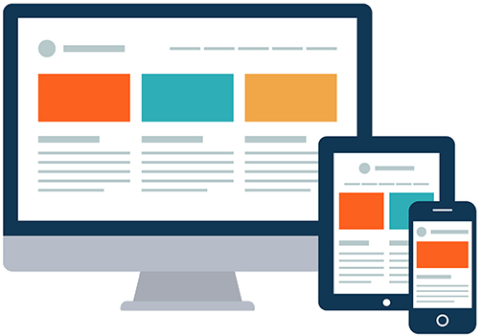
Google Crawler
Google crawler also known as bot or spider. A program that systematically browses the internet to discover and index web pages. By crawling and indexing web pages, it can provide relevant search results to users when they enter queries.
When the Google Crawler visits a web page, it analyzes the page’s content, including text, image and links. It follows the links on the page to other pages, and process continues recursively, leading to the discovery of more web pages.

Slide 5
The crawler role is to explore and gather information from the web, while other components process and rank the indexed pages to deliver the most relevant search results.
Several components are responsible for displaying the resultant websites on the Search Engine Results Page(SERP). These components work together to determine the ranking and presentation of webpage in response to a user’s search query.

Slide 6
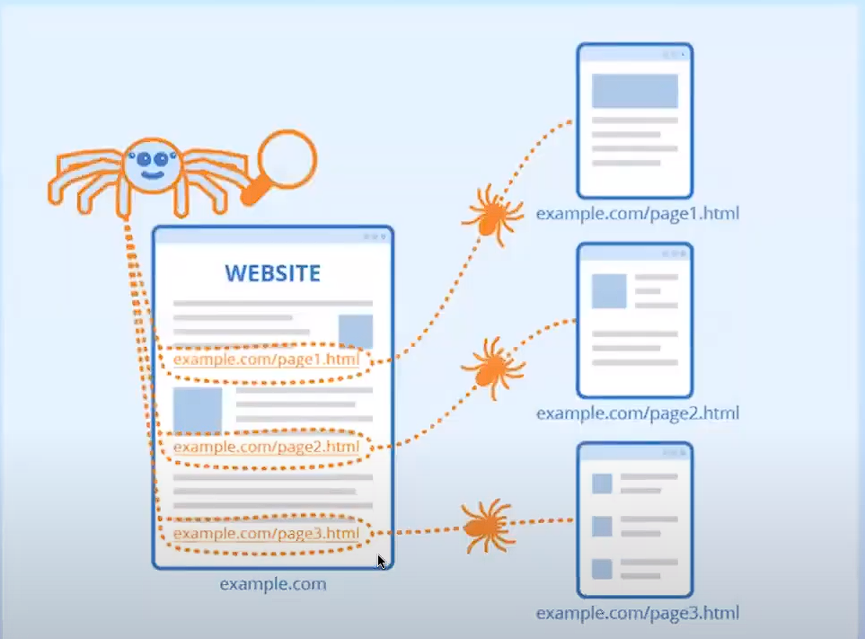

Slide 7
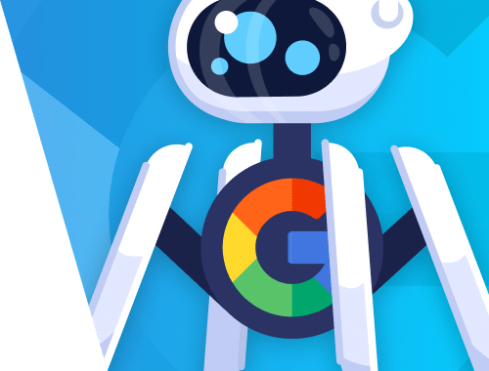
Google Crawler for Digital Marketing:
The data collected by the Google crawler is used to update Google’s index, which forms the basis for search engine ranking. When user enters search queries, Google retrieves relevant results from its index and presents them to the user.
Google Crawler plays a fundamental role in digital marketing by indexing web pages which is essential for digital marketing as it allows your website to be discovered by potential customer when they search for relevant keywords.
Understanding how Google Crawler operates and leveraging it effectively can significantly impact your website’s visibility and overall digital marketing success.

Slide 8
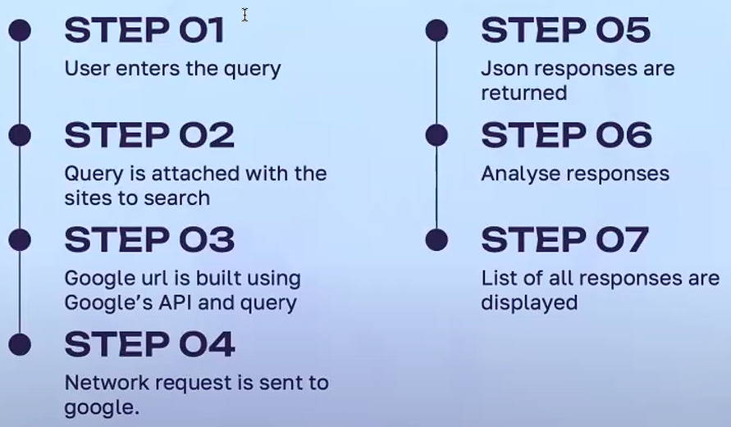
Working of Digital Crawler

Slide 9
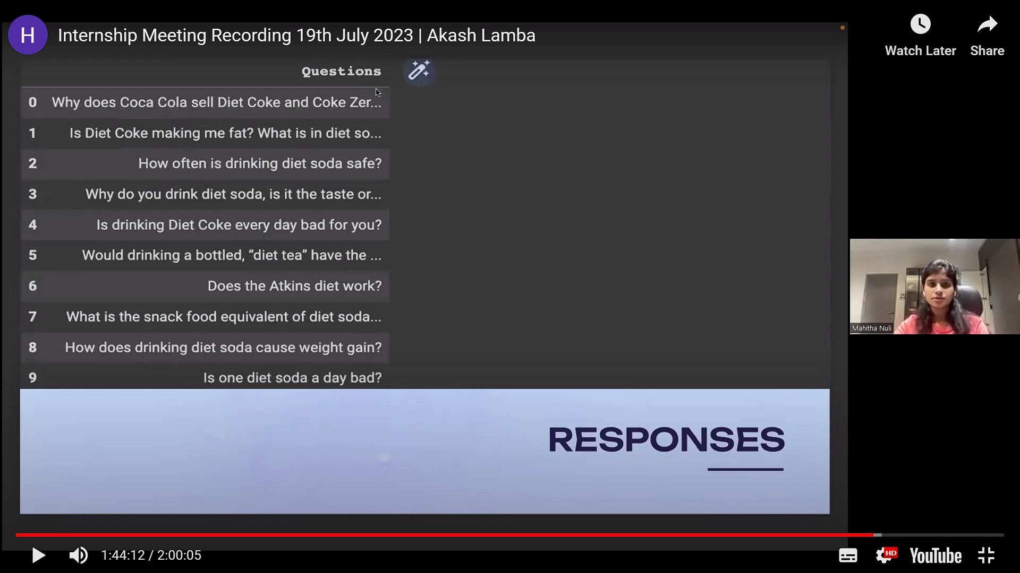
OUTPUT

Slide 10

Conclusion and Use Case
I was responsible for understanding and building the digital crawler tool. Building a digital crawler can be a powerful tool for various purposes, such as web scrapping , data extraction or automated data collection . A digital crawler allows you to gather data from websites or web APIs in an automated manner.
Digital crawlers have a wide range of applications, including market research, competitive analysis, sentiment analysis and more.

Slide 11


ANY QUESTIONS??
Connect with me: utsavd987@gmail.com

Slide 12

THANK YOU

